Slide 1




An open-source tool for orchestrating large scale heterogeneous workflows
Agnostiq Inc.
agnostiq.ai
AgnostiqHQ/covalent
@covalentxyz

Slide 2

Our Team
Alejandro Esquivel alejandro@agnostiq.ai
Ara Ghukasyan ara@agnostiq.ai
Santosh santosh@agnostiq.ai

Slide 3
What is a workflow?
Simply it is a set of automated tasks. Some examples are:
Train ML models, perform simulations, compute results: experiments
Process data
Transform the data
Compute a result
Act on the data e.g trigger external event (http call, notification, ect)
Provision cloud infrastructure, e.g Create S3 bucket, upload content. You have a live site!
… Anything you want to automate
Notes:
A workflow is a series of tasks to be performed
One can train ML models, perform simulations, compute results. Which we’ll call experiments
Can be used for data processing where data is transformed or computed upon to either return a result or invoke some action
Infrastructure can be provisioned
Anything really that can be automated..

Slide 4
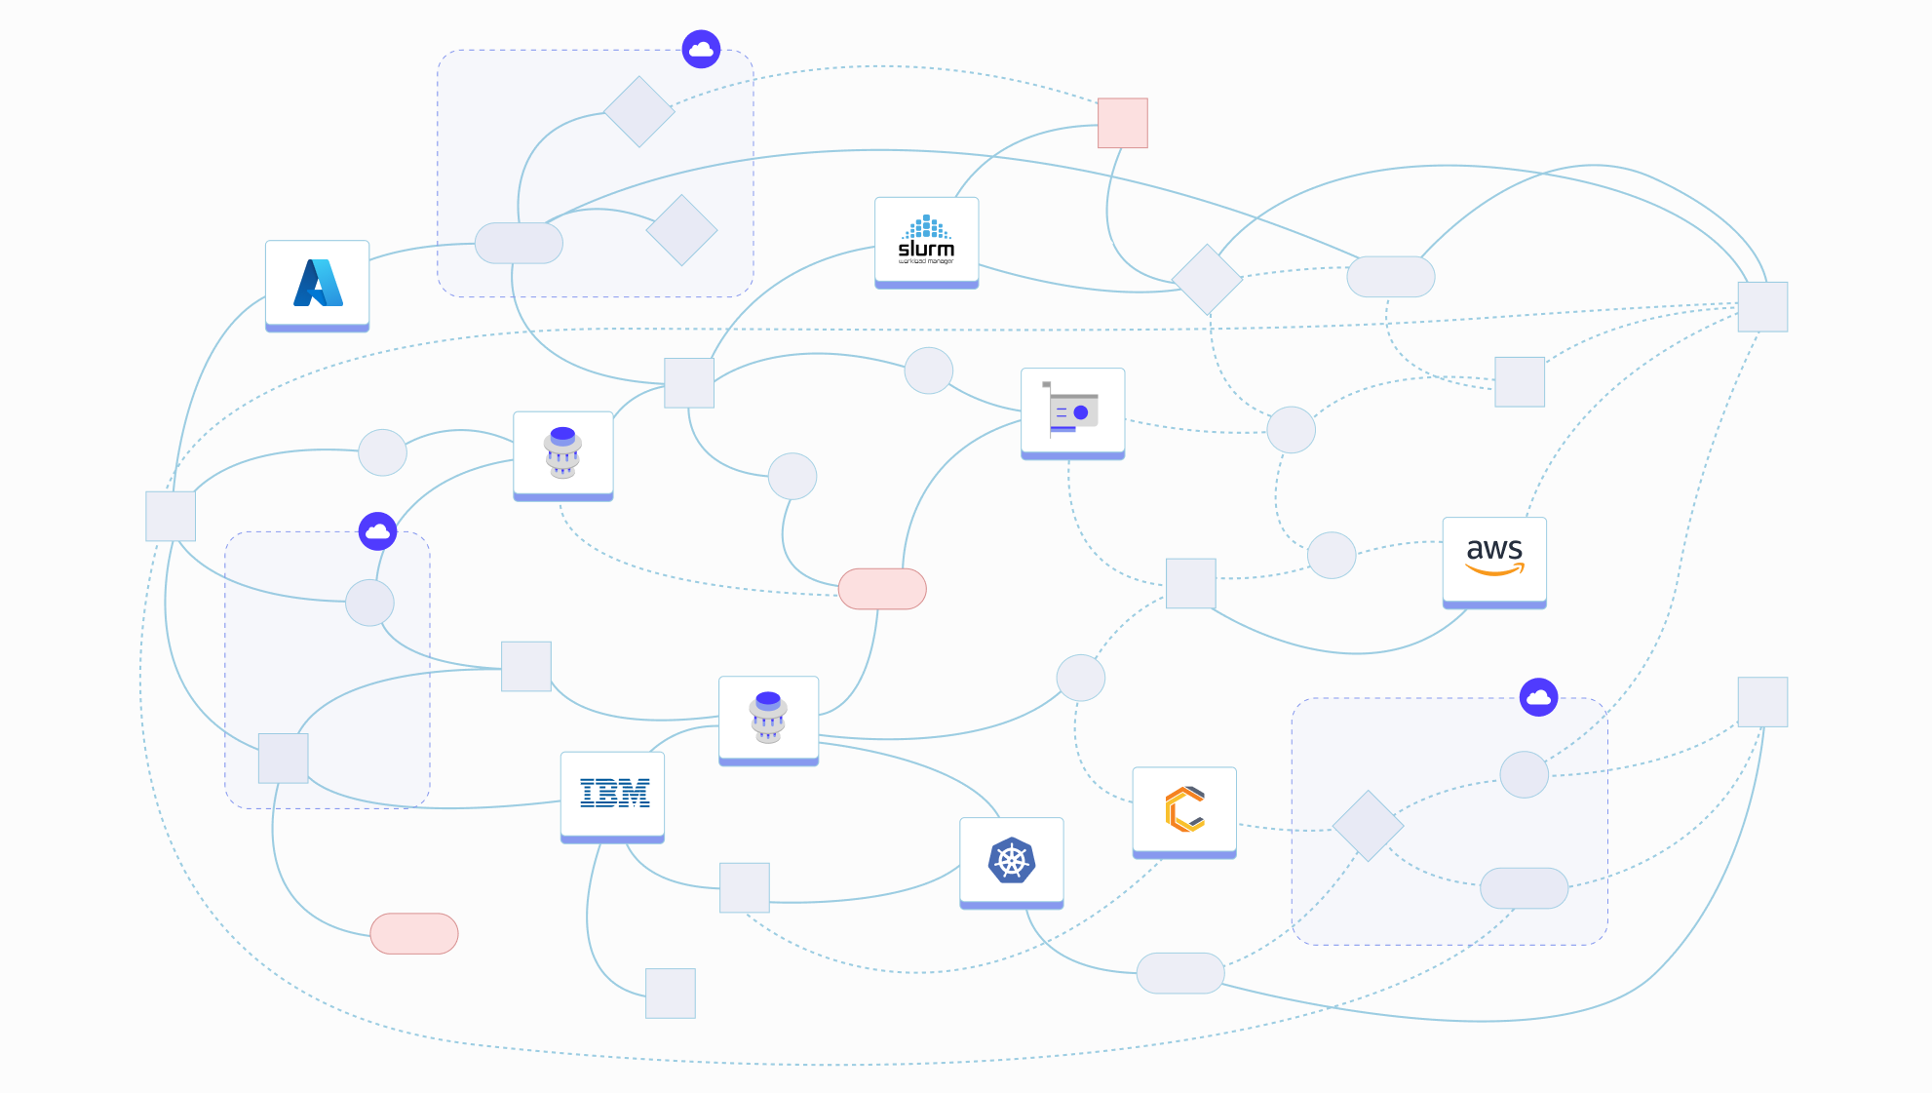
Modern computational workflows are complex
Notes:
While workflows are conceptually simple in practice can be quite complicated for real-world use cases
We may require to execute our tasks in different execution environments (be it on-prem, HPC clusters, cloud environments)
In some scenarios we may require a mix, and add different hardware requirements like GPUs, QPUs, ect.. And it can become quite difficult to manage
Loss of observability with custom tooling, track down tasks that may have failed along the way… As well as organizing results, and versioning different workflows

Slide 5
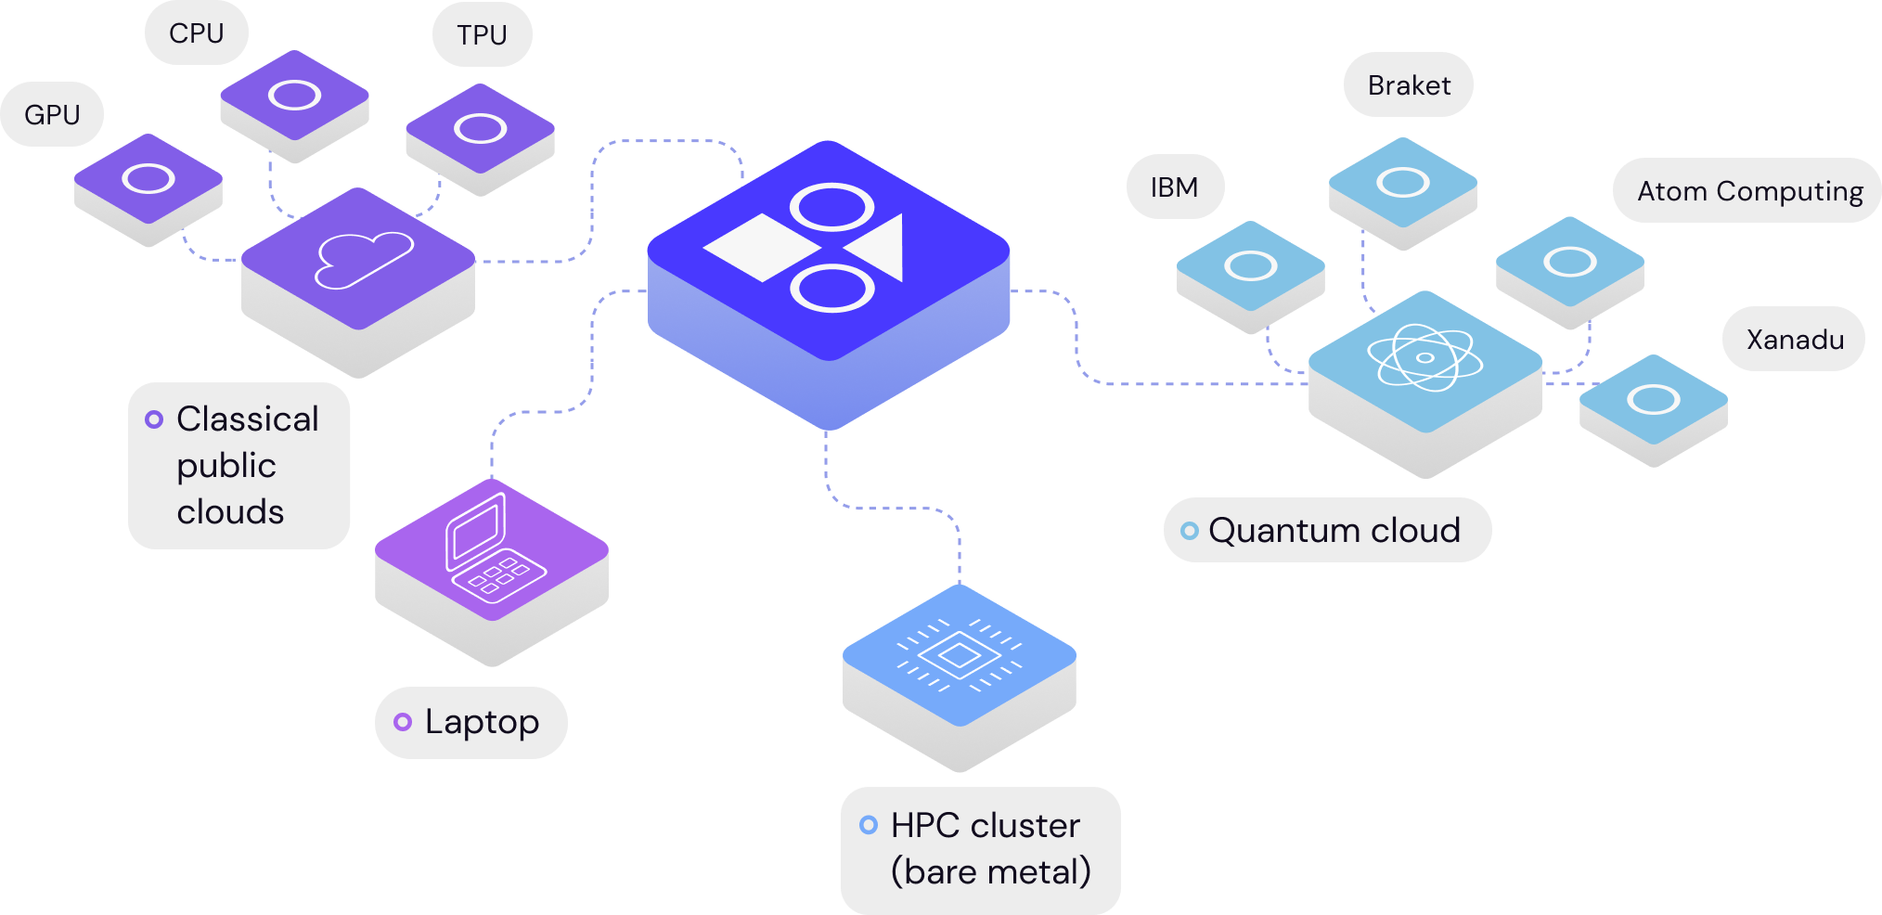
That’s where Covalent comes in…
Covalent is an open source, free pythonic workflow orchestration tool for heterogeneous computing
Notes:
Covalent is a free & open source workflow orchestration tool
Makes it easy to run tasks on any compute environment with the required hardware
And many more features

Slide 6
Some features Covalent offers
Parallelization
Run tasks in any compute backend (on-prem, cloud, HPC cluster)
Abstracts away hardware! GPUs, CPUs, QPUs
Scale way beyond your local compute environment!
Be re-usable and fault tolerant (automatic checkpointing)
Intuitive User Interface!
Manage experiments: versioning, share code & results
Identify failing tasks
Notes:
Offers parallelization out of the box, covalent determines task input/output dependencies and executes tasks in parallel whenever possible
Write code on your machine and have it run on any compute backend (on-prem, local, cloud, HPC clusters)
Mix and match compute backends that offer different hardware
Run as many tasks as you require, scalability

Slide 7
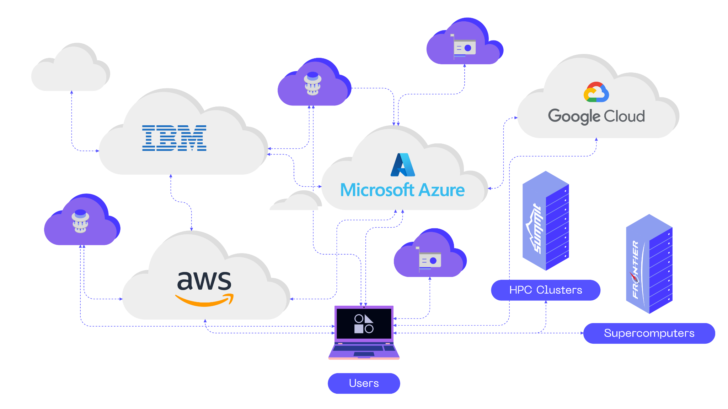
Heterogeneity is required to reach higher levels of compute more efficiently
AI/ML/Quantum workflows use combinations of CPUs, GPUs and QPUs to scale more efficiently
On-demand / bursting requirements
Diversity of resource types (CPUs, GPU arrays, quantum computers)
Combination of on-prem and cloud resources, multi-cloud (AWS, IBM,..)
Need to scale up and scale out
Efficiency yields faster results & cost savings
Notes:
ML training may require GPU hardware, but inefficient to consume expensive GPU compute resources for the entire training process when only a portion may really require it
To use quantum workflows practically we still leverage classical compute
To execute these types of workflow efficiently we then need to execute portions of our workflow using different hardware
Additionally we may execute some on-prem, some on cloud, or a combination of different cloud providers
Cloud resources can allow us to more easily scale up and down on demand
Combining all of these compute environments allow us to scale large workflows, lead us to faster results and cost savings

Slide 8
Using covalent is simple
1
2
3
4
5
6
7
8
9
10
11
12
13
14
16
17
18
19
20
21
import covalent as ct
@ct.electron(executor=AWSBatchExecutor())
def task(x, y):
z = optimize(x, y)
return z
@ct.electron(executor=SlurmExecutor())
def train(model):
import tensorflow as tf
tf.train(model)
return model
@ct.lattice
def workflow(inputs):
model = task(inputs[0], inputs[1])
return train(model)
dispatch_id = ct.dispatch(workflow)([1,2])
print(ct.get_result(dispatch_id))
1
2
3
4
5
6
7
8
9
10
11
12
13
14
def task(x, y):
z = optimize(x, y)
return z
def train(model):
import tensorflow as tf
tf.train(model)
return model
def workflow(inputs):
model = task(inputs[0], inputs[1])
return train(model)
print(workflow([1,2]))
Notes:
Write your code in python (or language of your choice)
Add some decorators and covalent works with your code as is
A workflow can be dispatched to Covalent for execution

Slide 9
Concepts
x
Electron
Granular tasks that comprise a workflow
Task
Task
Task
Task
1
2
3
(1)
@ct.electron
def task(x):
...
@ct.lattice
def workflow(inputs):
outputs = []
for x in inputs:
outputs.append(task(x))
return outputs
outputs
Lattice
Workflow defined by task interactions
(2)
Dispatch
Dispatch, and get your result.
(3)
dispatch_id = ct.dispatch(workflow)(inputs)
result = ct.get_result(dispatch_id, wait=True)
Notes:
Your individual functions or tasks correspond to electrons
The entrypoint of your workflow is referred to as a lattice
You can dispatch your lattice and get the result either synchronously or asynchronously

Slide 10
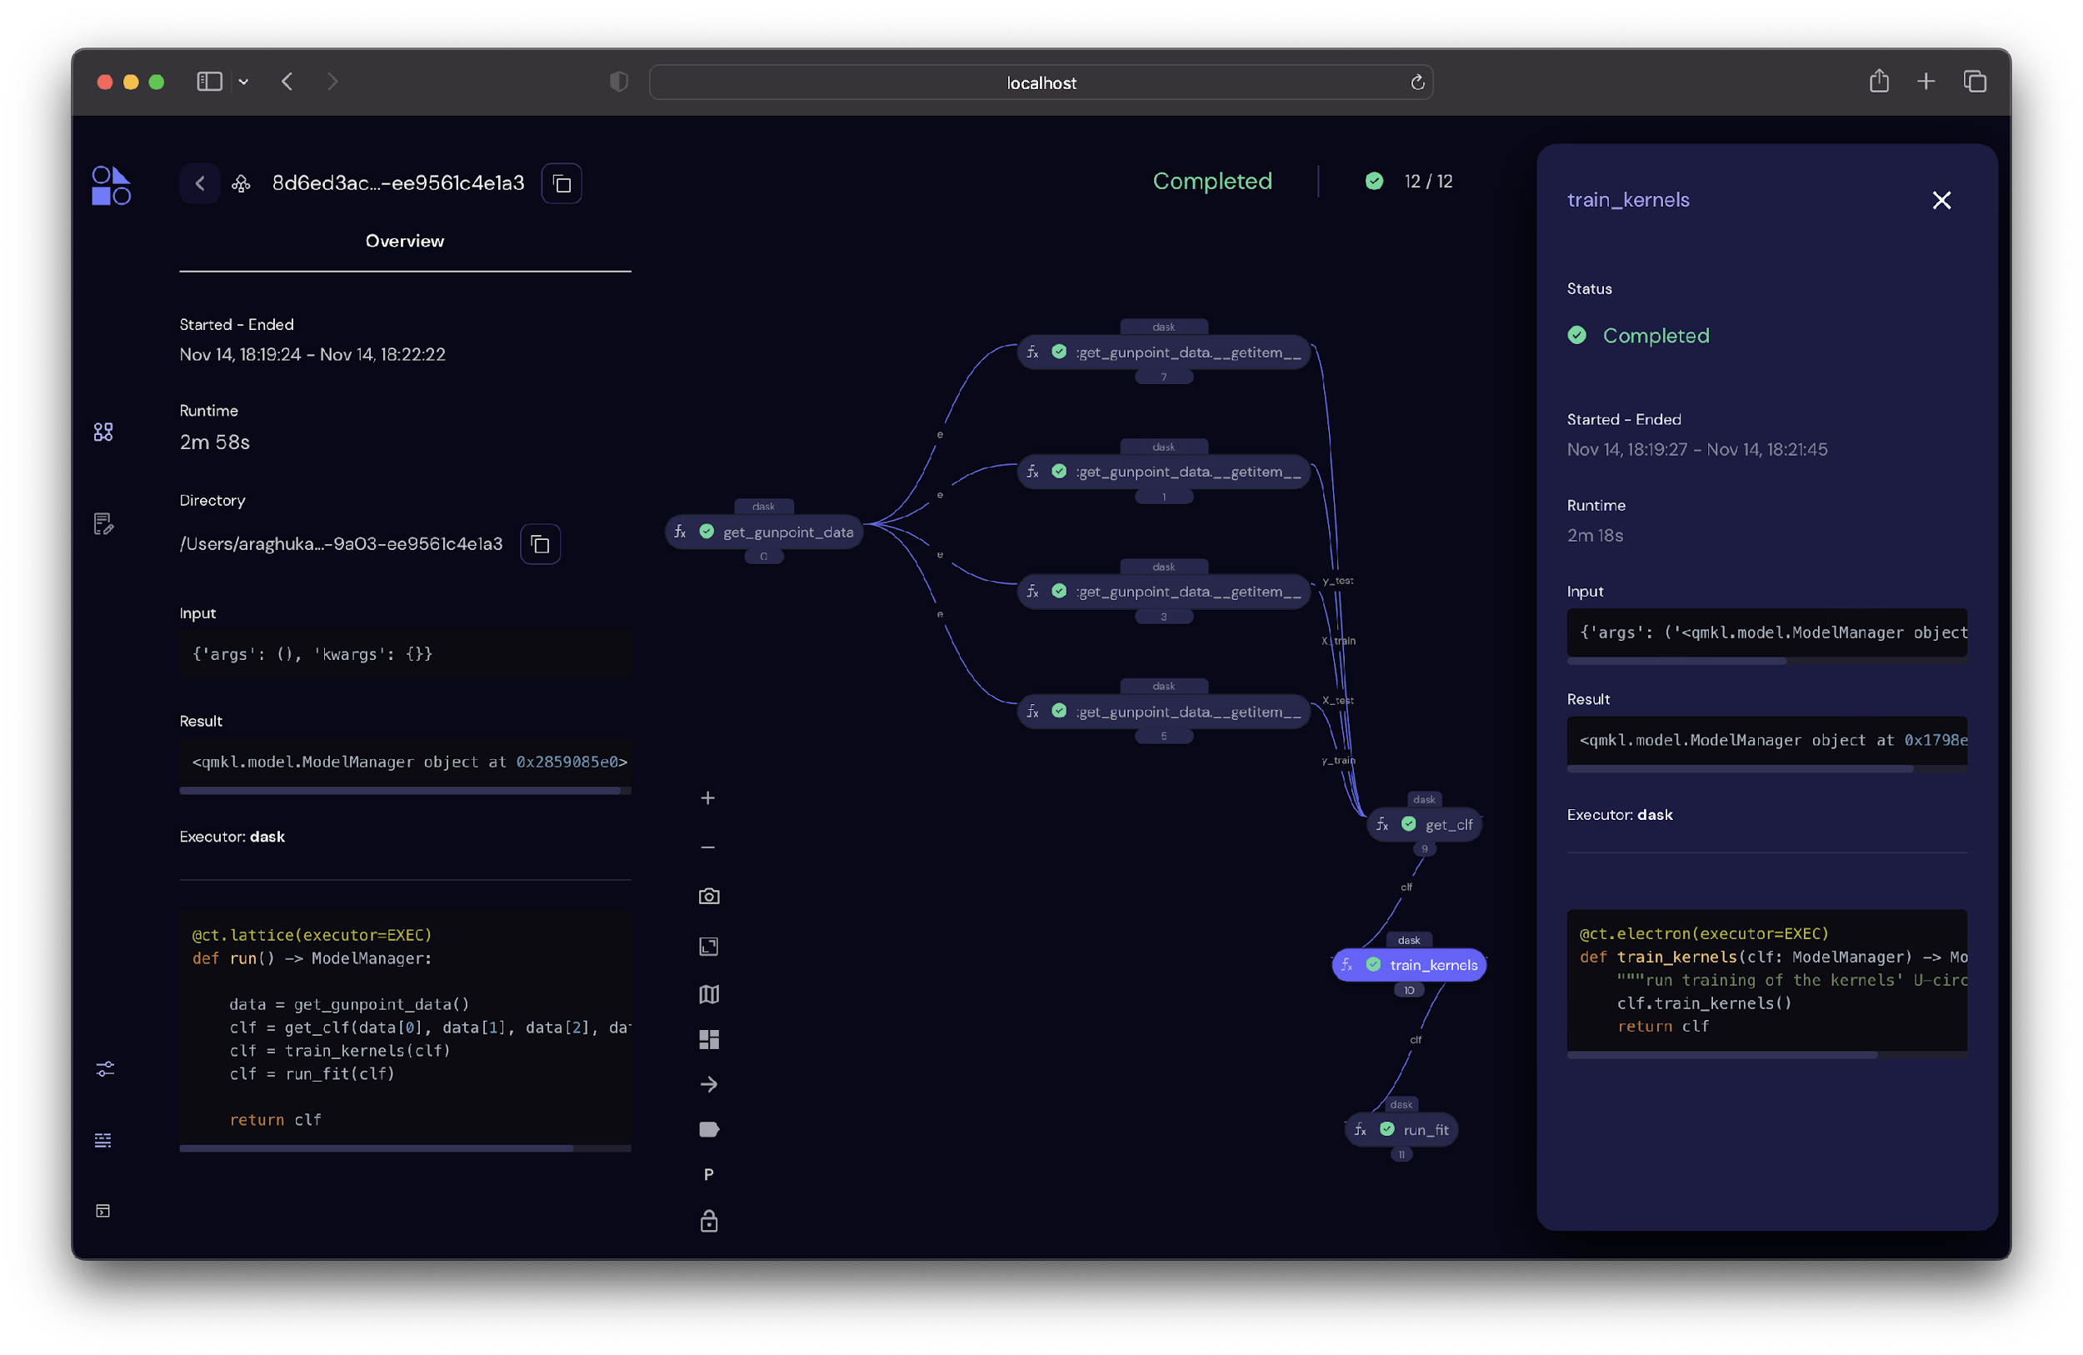

Slide 11
Getting started is easy
$ pip install covalent
$ covalent start
$ python workflow.py

Slide 12
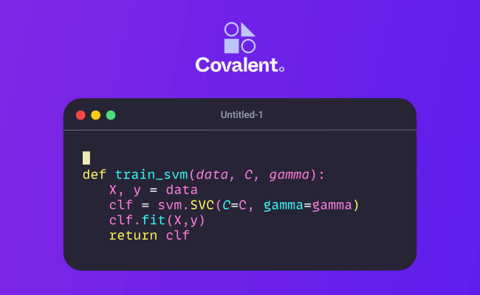
Covalent executor plugin ecosystem
$ pip install “covalent-aws-plugins[all]”

Slide 13
Workshop
Hosting Covalent & Dispatching Workflows
Please check us out & star @ github.com/AgnostiqHQ/covalent
Notes:
Things to show
Multiple workflows running/managing
Inputs/outputs cached
Combining multiple executors (On prem slurm - braket)
Setting all set default and can be configured
Dynamic workflows
Terminal to change things

